Slide 1
Bio Blocks
Amino Acid 3D Structure Learning Set for Students
CS7390 Special Topics on Digital Fabrication
Yangli Liu

Slide 2
PROBLEM
USABILITY CHALLENGE
MEMORY LIMITATIONS
Complex Interfaces: Traditional methods often present complex 2D representations, making it challenging for students to translate these into a mental 3D image.
Limited Interactivity: Lack of interactive tools impedes students' ability to manipulate and explore molecular structures in a meaningful way.
Information Overload: Overwhelming amounts of information without clear visual hierarchies can hinder the assimilation of 3D spatial concepts.
Cognitive Load: The cognitive load of memorizing and recalling 3D structures without interactive aids can overwhelm students.
Short-Term Memory: Visualizing complex structures in short-term memory is a cognitive challenge, especially when dealing with abstract molecular configurations.
Lack of Reinforcement: Insufficient reinforcement mechanisms contribute to memory decay, as students struggle to retain complex 3D spatial information over time.

Slide 3
Research goal
The primary research goal is to design, implement, and evaluate an interactive learning tool—the Amino Acid 3D Structure Learning Set—Bio Blocks. The aim is to improve students' comprehension of amino acid 3D structures by addressing usability challenges and capitalizing on memory reinforcement strategies.
Usability Enhancement
Memory Reinforcement
Evaluation Metrics
Objective: Identify and address usability challenges hindering students' comprehension of amino acid 3D structures.
Approach: Conduct usability analysis, optimize interface design in the React-based web app, and assess the impact on user interaction and understanding.
Objective: Investigate memory-related challenges and enhance retention through tactile learning strategies.
Approach: Analyze cognitive load, integrate a 3D-printed Lego Set, and conduct studies to measure the impact of hands-on engagement on long-term memory.
Memory Retention Studies: Conduct controlled studies to measure the impact of tactile learning on memory retention over time, comparing results with traditional learning methods.
Continuous Improvement: Collect and analyze user feedback iteratively to enhance the usability and memory reinforcement features of the tool

Slide 4
Systems to
Implement
User Interface (UI)
Develop an interactive React-based web application with 3D models of amino acids. Users can explore structures using mouse controls for rotation and navigation.
Design Representation
Conduct a detailed analysis of existing amino acid structures, translating findings into a comprehensive data representation system. This system will serve as the basis for generating Lego-style building blocks that accurately capture the spatial arrangement and unique characteristics of each amino acid.
3D Model Generation using Fusion 360
Utilize Autodesk Fusion 360 to design structural pieces of Lego building blocks. This phase involves meticulous crafting to capture the geometric intricacies of amino acids, ensuring accuracy and visual representation in each Lego-style component.
Downloadable Lego Pieces
Implement a feature for users to download customized Lego-style pieces in a printable file format (e.g., STL) for 3D printing.

Slide 5



Target Users
Educators: Science teachers and instructors seeking innovative teaching aids.
Students (K-12 and higher education): Individuals studying biology or related fields.
Parents: Supporting at-home learning experiences for children interested in science.

Slide 6
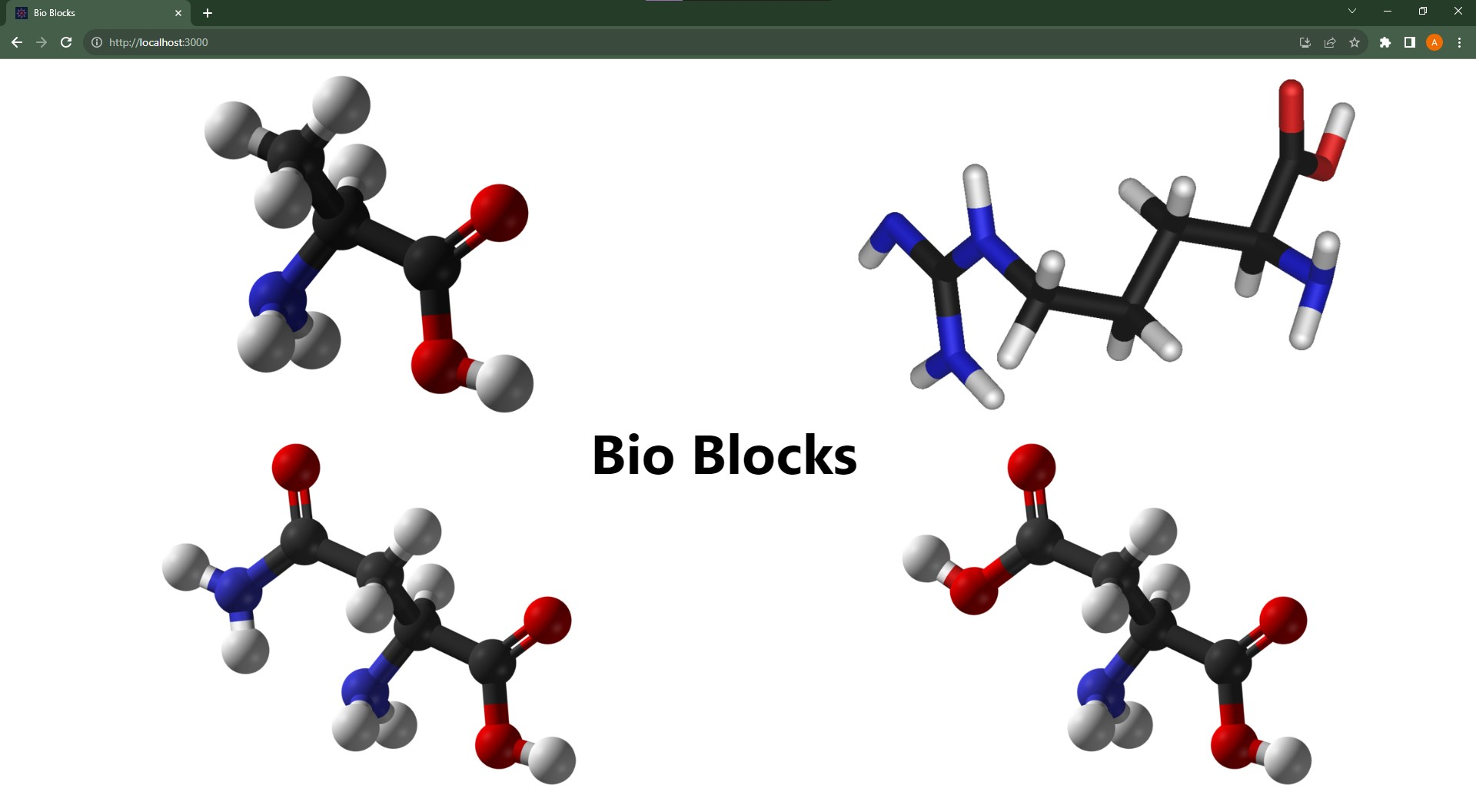
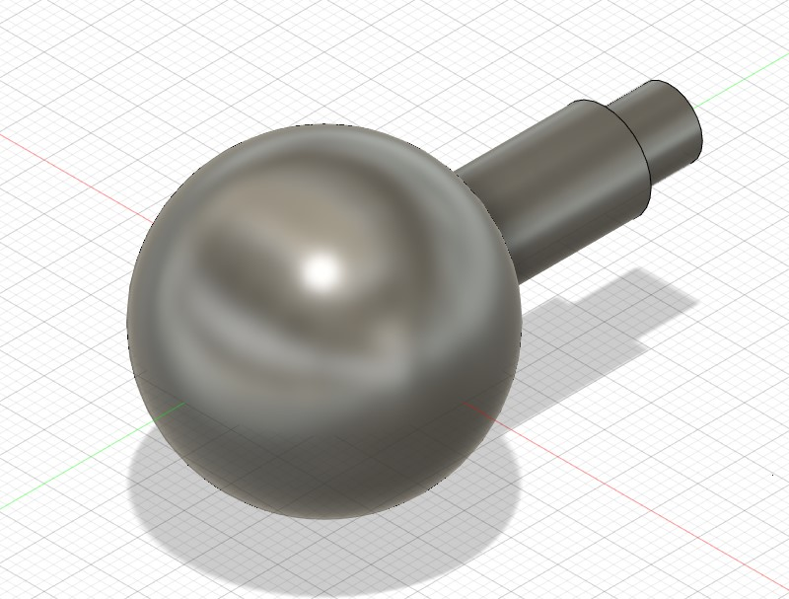
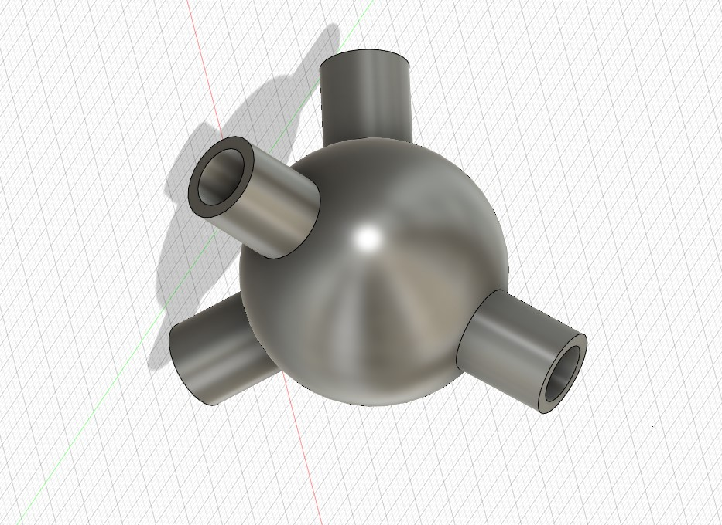
project OVERVIEW
Interactive 3D Amino Acid Models
Customized Lego-Style Pieces
Visual representations of amino acid structures for exploration and understanding.
Downloadable STL files of accurately designed Lego-style pieces corresponding to each amino acid, facilitating hands-on, tactile learning.

Slide 7
SUMMARY
The success of the project will be evaluated based on user feedback, engagement metrics, and the learning set's effectiveness in providing an accessible, enjoyable, and comprehensive tool for students to grasp the 3D structures of amino acids through interactive exploration and tangible, 3D-printed models. The accuracy and educational value of the Lego-style pieces will be assessed through user testing and feedback.

Slide 8
THANK YOU
Yangli Liu
liu.yangl@northeastern.edu
https://bio-blocks-lake.vercel.app/

